Slide 1
Optical Networks [EENGM0003]
Dr. George T. Kanellos
[gt.kanellos@bristol.ac.uk]

Slide 2
Session 9
Optical network control and management system

Slide 3
Optical network control and management system
Optical Network Control Plane
MPLS
GMPLS
Optical Network Management
Routing and Wavelength Assignment
Optical Network Survivability

Slide 4
Control Plane Functions
Routing - Intra-domain and Inter-domain
1) automatic topology and resource discovery
2) path computation (How do we use the infrastructure)
Signaling - standard communications protocols between network elements for the establishment and maintenance of connections
Neighbor discovery - NE sharing of details of connectivity to all its neighbors (very powerful tool)
Local resource management - accounting of local available resources

Slide 5
Control Plane : Distributed VS Centralized
Distributed Control:
Distributed control infrastructure and intelligence that controls the establishment and maintenance of connections in the network, including protocols and mechanisms to disseminate this information; and algorithms for engineering an optimal path between end points
Centralized Control:
Centralized control plane mechanisms supporting the above functionalities in a centralized way relying on client/ server model, usually involving one or more management applications (structured hierarchically) communicating to each network element in its domain

Slide 6
Control Plane : Distributed VS Centralized
Centralized Control Plane
Easier to implement
Single point of failure
Is not scalable with Size of network
Provisioning
Distributed Control Plane
Robust
More Complex
Scalable
We Discuss Distributed Control plane here
Centralized Control Plane
(Hierarchical )
Distributed Control
Plane
NE
NE
NE
NE
Protocols
NE
Protocols
NE

Slide 7
Why IP over WDM?
It is widely believed that IP provides the only convergence layer in the global and ubiquitous Internet
Most of the data traffic across network is IP
Nearly all the end-user data application uses IP
Conventional voice traffic can also be packetised with voice-over-IP
DWDM optical networks can address the continuous growth of the Internet traffic by exploring the existing fibre infrastructure

Slide 8
Problem Statement
Problem:
How to control and manage such an “All-IP” OTN network

Slide 9
MPLS
MPLS stands for: “Multi-Protocol Label Switching”
Goals:
Is considered a 2,5 layer protocol
Bring the speed of layer 2 switching to layer 3
Resolve the problems of IP over ATM, in particular:
Complexity of control and management
Scalability issues
Support multiple layer 2 technologies (SONET/SDH, ATM, Ethernet)
Allows for traffic engineering

Slide 10
Basic Idea
MPLS is a hybrid model adopted by IETF to incorporate best properties in both packet routing & circuit switching
IP Router
MPLS
ATM Switch
Control:
Control:
Control:
IP Router
Software
IP Router
Software
ATM Forum
Software
Forwarding:
Forwarding:
Forwarding:
Longest-match
Lookup
Label Swapping
Label Swapping
Notes:
Internet Engineering Task Force

Slide 11
MPLS
Initially designed for packet switched electronic networks
To improve performance and scalability
Traffic Engineering (put the traffic where the bandwidth is)
To be link layer independent
To work transparently with existing L2 switching protocols
To be network layer independent
To coexist with native: routing (IP) and switching (ATM)
To support services beyond best-effort
To support “aggregate forwarding”
streams of data to be forwarded as a single entity between LSR
To support future Applications
Universal Control Plane

Slide 12
What is Label Switching?
In a traditional IP network:
Each router performs an IP lookup (“routing”), determines a next-hop based on its routing table, and forwards the packet to that next-hop.
MPLS does “label switching” instead:
The first device does a routing lookup, just like before
But instead of finding a next-hop, it finds the final destination router.
And it finds a pre-determined path from source to that final router.
The path is called LSP: Label-switched Path
The router applies a “label” based on this information.
Subsequent routers use the label to route the traffic without needing to perform any additional IP lookups.
At the final destination router the label is removed.

Slide 13
MPLS Principle: The Label Information Base
Label switched router
Label forwarding table
Connection Table
Port 1
Port 3
In
(port,Label)
Out
(port, Label, Operation)
5
(1, 5)
(4, 7, Swap)
(1, 3)
(4, 27, Swap)
(1, 17)
(4, 123, Swap)
7
(2, 3)
(3, 17, Push)
Port 2
Port 4
Labeled packet arrives at Port 1, with Label value "5“
LSR extracts label and uses it to index into the forwarding table
Label entry indicates switch to Port 4
and swap label to value "7"

Slide 14
MPLS Labels
Labels are identifiers used in forwarding
Label values have meaning between two nodes NOT end-to-end
There may be multiple labels stacked per packet
Format:
MPLS Label Stack
n
•••
1
Layer 2 Header
(eg. PPP, Ether,
ATM, Frame Relay)
Network Layer Header
and Packet (eg. IP)
4 Octets
Label Stack
Entry Format
Label
Exp.
S
TTL
Label: Label Value, 20 bits (0-16 reserved)
Exp.: Experimental, 3 bits (Class of Service is one use)
S: Bottom of Stack, 1 bit (1 = last entry in label stack)
TTL: Time to Live, 8 bits

Slide 15
MPLS Basics
Label Switch Router
MPLS Domain
Label Switch Path
Transit
Ingress
Egress
MPLS Domains
MPLS Nodes and Label Switch Routers
Label Switch Path
Label Edge Routers
Ingress, egress and transit nodes

Slide 16
MPLS Operation
1a. Routing protocols (e.g. OSPF-TE, IS-IS-TE) exchange reachability to destination networks
4. LER at egress removes label and delivers packet
1b. Label Distribution Protocol (LDP)
establishes label mappings to destination network
IP
IP
10
IP
20
IP
40
IP
2. Ingress LER receives packet and “label”s packets
3. LSR forwards packets using label swapping

Slide 17
MPLS Operation
Packets are switched, not routed, based on labels
Labels are filled in the packet header
Basic operation:
Ingress LER (Label Edge Router) pushes a label in front of the IP header
LSR (Label Switch Router) does label swapping
Egress LER removes the label (POP)
The key : to operation of MPLS
Link state routing protocols
Exchange network topology information for path selection
OSPF-TE, IS-IS-TE
Signaling/Label distribution protocols:
Set up LSPs (Label Switched Path)
LDP, RSVP-TE, CR-LDP

Slide 18
MPLS Routing
To compute LSP, LSRs collect network topology and resource information about each link
Paths are computed to avoid links that cannot support the service level of an LSP (e.g. link with insufficient bandwidth)
OSPF-TE and ISIS-TE Extensions
Provides information for path selection
Aka Shortest Path first - SFP/ Constrained Shortest Path First - CSFP
carry information related to link attributes/states, to be used for explicit route calculation (e.g. available/reserved bandwidth)
Is used for finding/calculating TE path
Traffic engineering metric
Maximum bandwidth
Maximum reservable bandwidth
Unreserved bandwidth
Administrative group
Also called Resource Class/Color
Notes:
Open shortest path first

Slide 19
MPLS signaling
To use an LSP, it must be signaled across your routers.
An LSP is a network-wide tunnel, but a label is only a link-local value.
An MPLS signaling protocol maps LSPs to specific label values.
There are two main MPLS routing protocols in use today:
Label Distribution Protocol(“LDP”) : A simple non-constrained (doesn’t support traffic engineering) protocol.
Resource Reservation Protocol with Traffic Engineering (“RSVP-TE”) : A more complex protocol, with more overhead, but which also includes support for traffic-engineering via network resource reservations.

Slide 20
Signaling: LDP (Label Distribution Protocol) Operation
Peer Discovery
Transport connection establishment
Session initialization
Label exchange
Session maintenance
Hop-by-Hop operation

Slide 21
Signaling: LDP Operation
Routes Labels
63.74.77.0/24 92
198.254.24.0/23 92
Routes Labels
192.233.197.0/24 28
209.80.0.0/18 28 63.74.77.0/24 65
198.254.24.0/23 65
Routes
192.233.197.0/24
209.80.0.0/18 63.74.77.0/24
198.254.24.0/23
Routes
63.74.77.0/24
198.254.24.0/23
Ingress LSR send Label Request Messages to Egress LSR to setup LSP
Includes one or more hosts/prefixes
Request and Reply messages follow paths that are limited to IP shortest path routes
LSP are along shortest paths
Egress LSR send Label Mapping Messages

Slide 22
Interesting MPLS aspects
Separation of control and Data plane
packet forwarding in each router decoupled from label switching and LSP taken up and down in the network
Independent network control mechanisms
LSP set up and down based on different criteria using different protocols
2. Packet forwarding processing
LSR can process more packets
Label switching and forwarding is simpler and performed in hardware

Slide 23
Interesting MPLS aspects
Connection Oriented:
IP packets are forwarded based on the destination address→ same address means same link
MPLS connection is oriented: Packets are organized in packet streams called forward equivalent classes (FEC)
Packets with different service requirements are grouped in different FEC
Each FEC has an LSP
Allows Traffic Engineering (TE) (load balancing, avoid congestion)
MPLS allows multiple VPN over single IP network
Explicit Routing
IP routing follows shortest path
MPLS allows explicit routing: LSP can be chosen to offer certain QoS assurances (e.g links with sufficient reserved bandwidth)

Slide 24
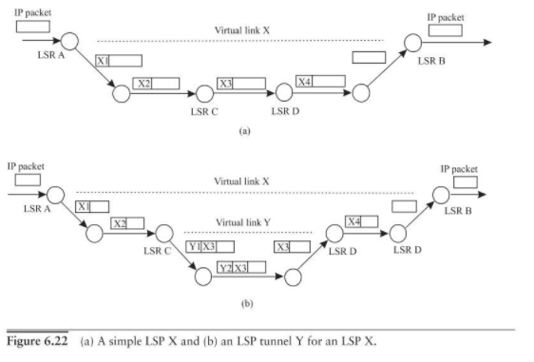
MPLS tunnelling and label stacking

Slide 25
Lambda as a Label in MPLS (MPλS)
Multiprotocol Lambda Switching (MPλS) is the optical analogy of MPLS.
Wavelength is the new label
Labels in MPLS can be viewed as analogous to optical channels in optical networks.
LSRs are viewed as analogous to OXCs.
The data plane of an LSR uses the label-swapping paradigm to transfer a labelled packet from an input port to an output port.
The data plane of an OXC uses a switching matrix to connect an optical channel (OCh) trail from an input port to an output port.

Slide 26
Lambda as a Label in MPLS (MPλS)
Case 1a: No wavelength translation
Connection Table
Port 1
Port 3
In
(port,Lambda)
Out
(port, Lambda)
Λ2
(1, Λ2)
(4, Λ2)
(1, Λ3)
(4, Λ3)
(1, Λ1)
(4, Λ2)
Λ2
(2, Λ1)
(3, Λ1)
Port 2
Port 4
Channel arrives on Port 1 on Λ2, the "green" lambda
Connection table indicates that this channel should be space-switched to Port 4
At Port 4, Λ2 is available for onward transmission

Slide 27
Lambda as a Label in MPLS (MPλS)
Case 1b: No wavelength translation
Connection Table
Port 1
Port 3
In
(port,Lambda)
Out
(port, Lambda)
Λ3
(1, Λ2)
(4, Λ2)
(1, Λ3)
(4, Λ3)
(2, Λ3)
(4, Λ1)
Λ3
(2, Λ1)
(3, Λ1)
Port 2
Port 4
Channel arrives on Port 1 on Λ3, the “grey" lambda
Connection table indicates that this channel should be space-switched to Port 4
At Port 4, Λ3 is available for onward transmission

Slide 28
Lambda as a Label in MPLS (MPλS)
Case 2: Wavelength translation
Connection Table
Port 1
Port 3
In
(port,Lambda)
Out
(port, Lambda)
(1, Λ2)
(4, Λ2)
(1, Λ3)
(4, Λ3)
(2, Λ3)
(4, Λ1)
Λ3
Λ1
(2, Λ1)
(3, Λ1)
Port 2
Port 4
Channel arrives on Port 2 on Λ3, the “grey" lambda
Connection table indicates that this channel should be space-switched to Port 4
At Port 4, Λ3 is already in use, so lambda is translated to Λ1, the "red" lambda

Slide 29
Generalized MPLS(GMPLS)
Very active area within the IETF - Generalized MPLS (GMPLS)
Developed from MPLS
generalize the concept of a “label”
A previous version is “Multi-Protocol Lambda Switching”
Extend the MPLS to support more interfaces other than packet switch
Packet Switch Capable (PSC)
Router/ATM Switch/Frame Reply Switch
Time Division Multiplexing Capable (TDMC)
SONET/SDH ADM/Digital Cross connects
Lambda Switch Capable (LSC)
All Optical ADM or Optical Cross connects (OXC)
Fiber-Switch Capable (FSC)
LSPs of different interfaces can be nested inside another
consistent path establishment across variety of technologies

Slide 30
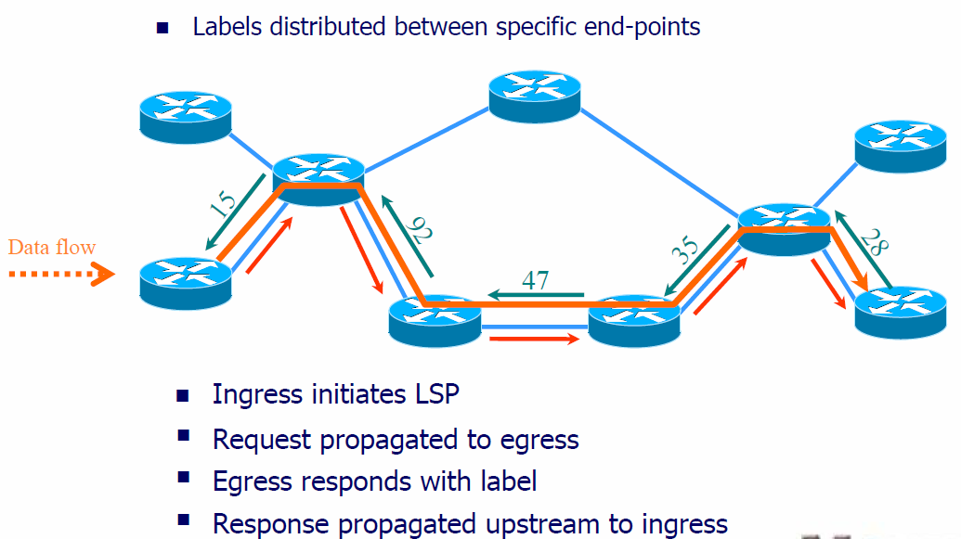
GMPLS Controlled Lightpath
Reuse of MPLS and IP Control
λ⁵
λ²
λ⁸
Data flow
λ²
λ²
Ingress initiates lightpath setup
Request propagated to egress
Egress responds with lambda
Response propagated upstream to ingress

Slide 31
Packet and Cell Switching
“label” == shim header
if0
if1
MPLS
pkt0
pkt2
pkt0
pkt2
if100
if101
pkt0
pkt2
pkt0
pkt2

Slide 32
TDM (SONET/SDH) Switching
“label” == TDM time slot
λ₁
λ₁
τ₀
τ₂
TDM
τ₀
τ₂
λ₁₀₀
λ₁₀₀
τ₀
τ₂
τ₀
τ₂

Slide 33
Lambda Switching
“label” == lambda frequency
{λ..λ}₁
λ₁
λ
{λ..λ}₁
OEO
λ₁₀₀
λ_{p} − λ₁
{λ..λ}₁₀
OOO
{λ..λ}₁₀
λ₁₀₀
λ₁₀₀

Slide 34
Port Switching
“label” == fiber port
Fiber #1
Fiber #1
Fiber #1
Fiber #N
Fiber #N
Fiber #1
Fiber #1
Fiber #1
Fiber #N
Fiber #N

Slide 35

Generalized MPLS
GMPLS is a superset of MPLS and MPλS
Apply MPLS control plane techniques to optical switches and IP routing algorithms to manage lightpaths in an optical network
GMPLS made some modifications on MPLS
Separation of signaling and data channel
Support more types of control interface
Other enhancement
GMPLS Control Plane
RSVP-TE, CR-LDP OSPF, IS-IS
Data Plane
MPLS, SONET/SDH, λs/WDM, Ports

Slide 36
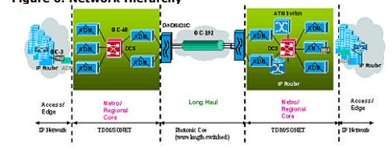
Generalized Labels
MPLS labels are a simple 32 bit quantities
Extend the MPLS to support more interfaces other than packet switch
Packet Switch Capable (PSC)
Router/ATM Switch/Frame Reply Switch
Time Division Multiplexing Capable (TDMC)
SONET/SDH ADM/Digital Crossconnects
Lambda Switch Capable (LSC)
All Optical ADM or Optical Crossconnects (OXC)
Fiber-Switch Capable (FSC)
LSPs of different interfaces can be nested inside another
Natural hierarchy is established
PSC
TDMC
LSC
FSC
TDMC
LSC

Slide 37
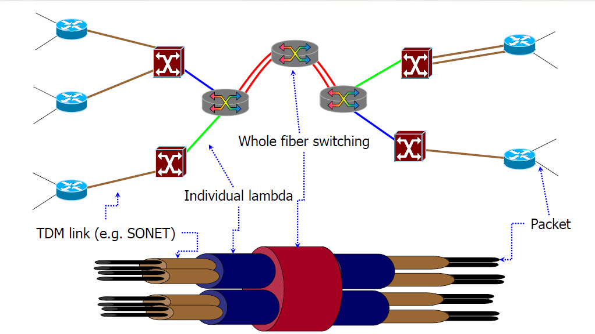
Switching Hierarchy

Slide 38
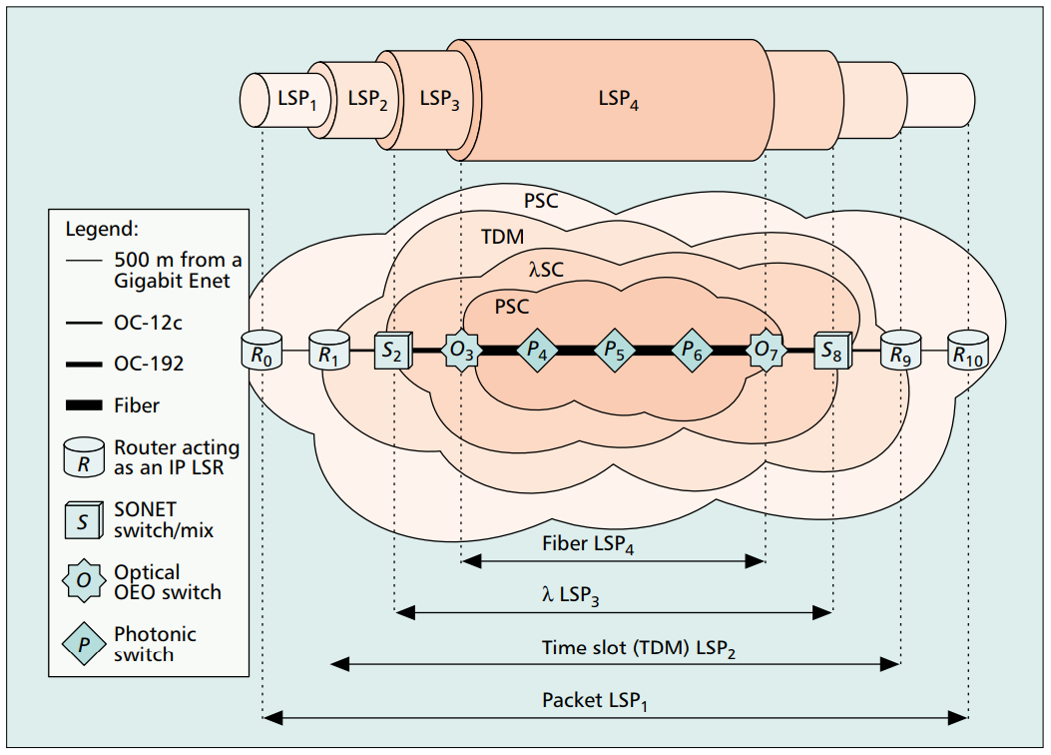
Hierarchical LSP

Slide 39
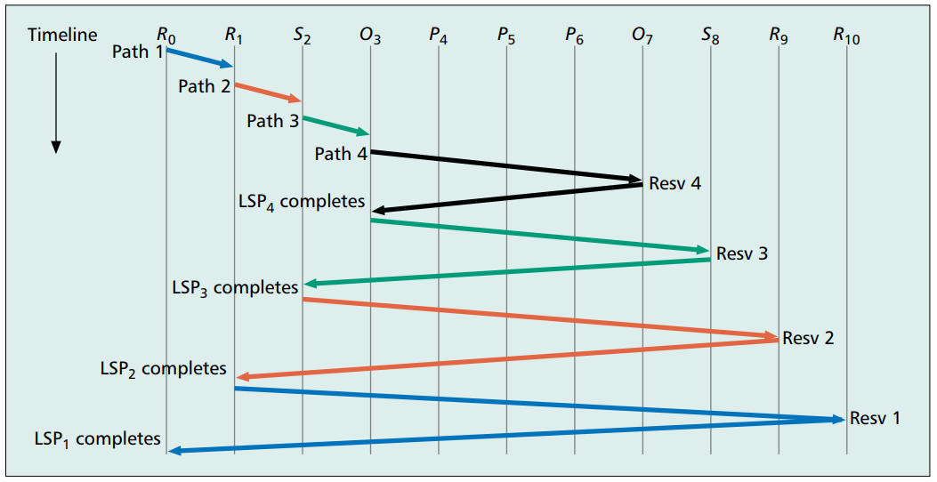
GMPLS LSP formation
A Path request (Path 1) is generated at R0 that is sent to R1.
At node R1 (a boundary node) this arrival triggers a requirement for a new LSP (LSP2) from R1 to R9.
These dynamic LSP creation requests are triggered until Path 4 is generated at O3.
Following successful establishment of LSP4, the Path 3 message is tunneled through LSP4.
a lower-level LSP creation request being tunneled through the higher-level LSP so formed, continues until the initial LSP (LSP1) is successfully created, thus forming a hierarchy.

Slide 40
GMPLS and MPLS Differences (Routing Extension)
Extensions to routing (Mainly OSFP) to support
Routing and wavelength/time slot assignment
Interface Switching Capability
Identifies type of switching supported and Maximum LSP bandwidth per priority

Slide 41
End of session 9
Part 1

Slide 42
Optical Networks [EENGM0003]
Dr. George T. Kanellos
[gt.kanellos@bristol.ac.uk]

Slide 43
Link Management
Need to manage and maintain the health of the control and data planes between neighboring nodes:
Need to address a common set of issues
Isolation of faults transparent networks
Scale the number of links without increasing configuration
Handle case where transmission (e.g., WDM) and switching are separated = very large number of component / per-lambda links
New protocol needed to resolve these issues, e.g. LMP (Link Management Protocol)

Slide 44
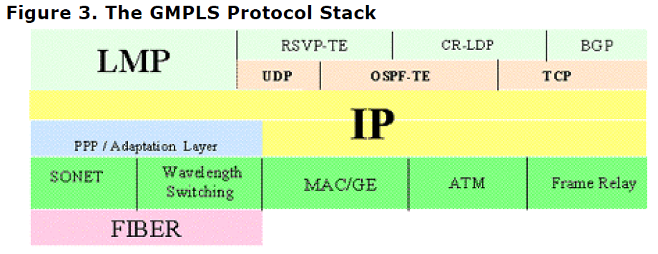
LMP - Link Management Protocol
Control Channel Management
Negotiate link parameters (keep-alive messages) and ensure health of a link (hello protocol)
Link Property Correlation
Discover and agree data link properties of adjancent nodes
Link Verification
Map interface IDs and verify data connectivity (PING-like test message)
Fault Management
Detect and isolate faults

Slide 45
Network Management functions
Performance Management
Monitor and Measure the performance of the network (QoS)
Fault management
is the function responsible for detecting failures when they happen and isolating the failed component.
Conﬁguration management
Resource management (managing the equipment, routing)
connection management (setting up, taking down, and keeping track of connections)
adaptation management: convert external client signals into appropriate signals inside the optical layer.
Security management
administrative functions such as authenticating users and setting attributes such as read and write permissions on a per-user basis.

Slide 46
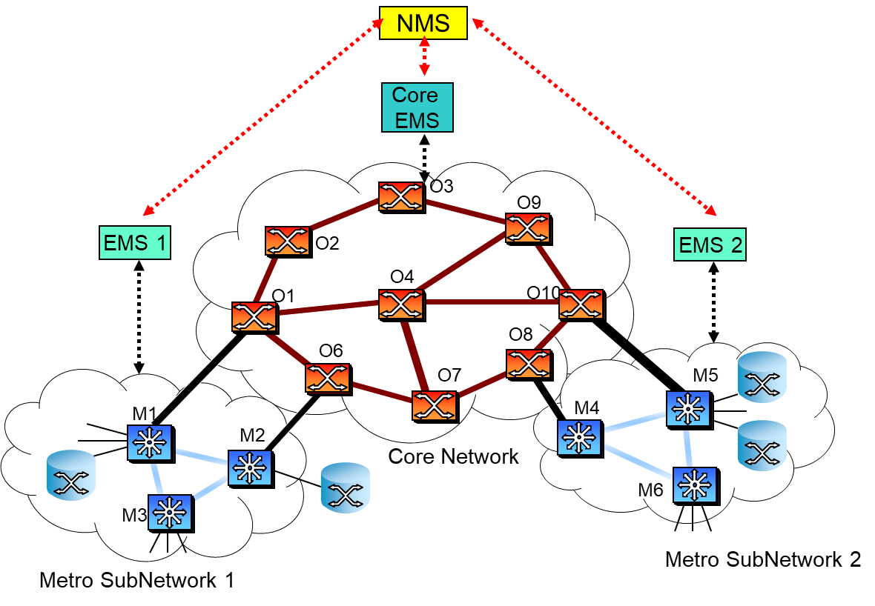
Layered Network Management
Multiple layers of management
Management functionality in each network element and support on each communications link
Element management system (EMS): Manages a subnetwork of the network elements
Network management system (NMS): talks to the EMSs to get the overall view of the network.

Slide 47
Optical Network Management
Management Plane
Control plane is positioned between transport and management planes.
NEs are controlled either by control plane or by both management plane and CP.
Management plane, configures and supervises the Control plane .
Routing constraints, policy
Performance monitoring
Management plane has ultimate control over all transport plane and control plane entities.
Management plane is also manage/control inter domain networking and connection establishment
Control
Plane
(Embedded Controller)
Transport Plane
OTN
Notes:
This slide shows the distribution of the support to four types of CP interfaces. These are the I-NNI for intra-domain, E-NNI for inter-doamin CP, the network side of UNI and client side of UNI. Team C supports full peer model and needs only to implement I-NNI interface. Team B shows a uniform support of all four CP interface types. This will provide a rich set of interoperability test scenarios.

Slide 48
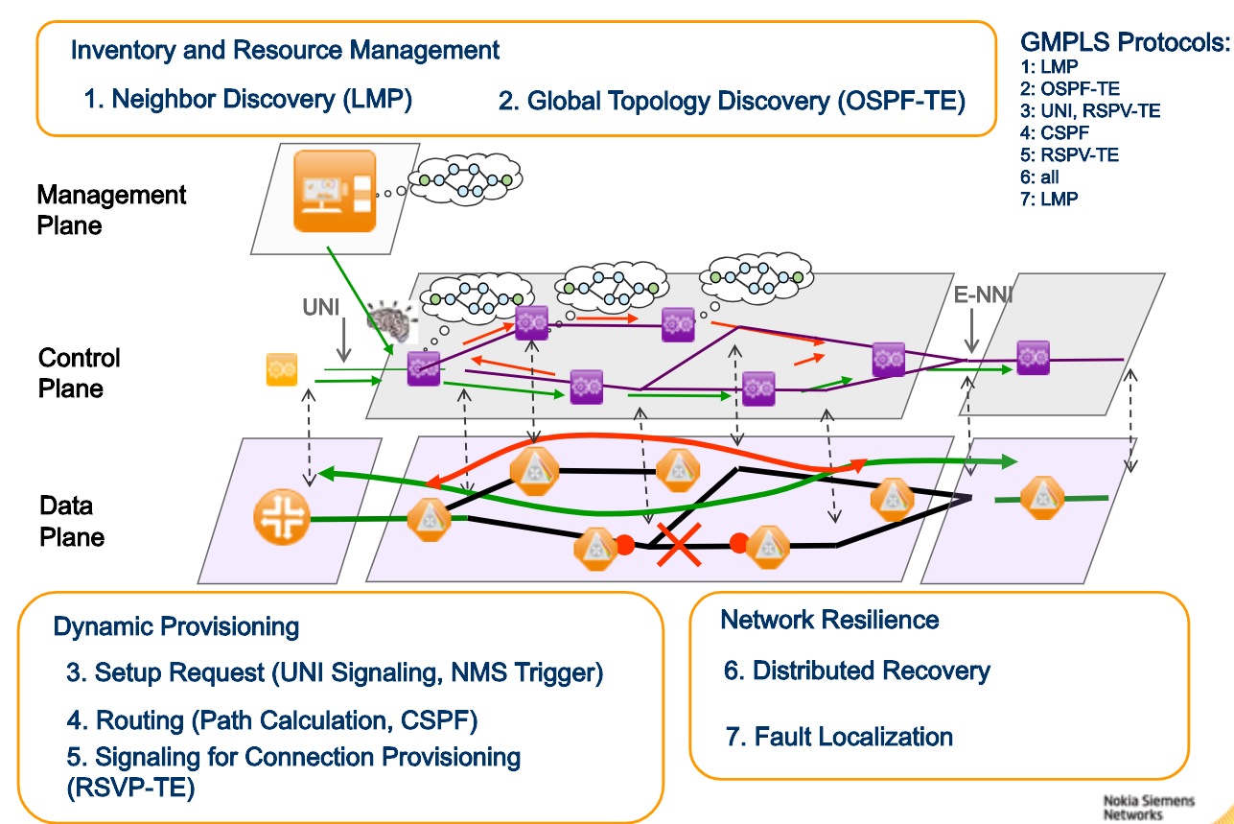
Optical Network Management

Slide 49
Optical Network Optimization (WDM Network)
Optimization Objective
Route all the lightpaths using the minimum number of wavelengths
Route all the lightpaths using the minimum number of fibers
Route all the lightpaths minimizing the total network cost, taking into account also switching systems
This can be achieved by appropriate Routing and Wavelength Assignment (RWA) algorithms
Offline
For all light paths in advance
Requires knowledge of all connectivity request in advance
Online
For light path connectivity demands coming during operation

Slide 50
Routing and Wavelength Assignment (RWA)
Input parameters:
a set of lightpaths that need to be established in the network
physical topology
number of fibers and number of wavelengths on fiber
constraints: e.g., wavelength continuity, physical impairments, survivability, etc
Objective :
Find the routes over which these lightpaths should be set up
the wavelengths which should be assigned to these lightpaths meet all constraints
Lightpath is blocked when it can not be setup due to lack of resources (routes and/or wavelengths) or due to other constraints
The corresponding network optimization problem is to minimize the blocking probability

Slide 51
RWA Constrains
Wavelength continuity
Wavelength continuity constraint can be alleviated by wavelength converter functionality at all or some selected nodes
No wavelength conversion functionality in the network lightpaths operate on the same wavelength across all fiber links
Lightpath may switch between different wavelengths on its route from its origin to its termination
Tradeoff: cost vs. performance
Physical Constraints
Directly related to the nature of the optical physical medium and transparent transmission
Optical signal impairments affect the quality of the lightpaths Limiting reach of the lightpaths
Physical impairments can be mitigated by signal regeneration
3R regeneration: Re-amplification, Re-shaping and Re- timing
Tradeoff: cost vs. performance

Slide 52
RWA Methods
Integer Linear Programming (ILP) formulation
Mathematically optimized routing model
Heuristically optimized routing methods
Routing methods
Shortest Path
selects the shortest source- destination path (# of links/nodes)
Least Loaded Routing
avoids the busiest links
Least Loaded Node
avoids the busiest nodes

Slide 53
Network Survivability
Network Survivability Definition: The process of transferring client service on to spare network capacity in the event of failure in the network
One of the most important assets of future all-optical networks will be survivability. The enhancement of the transport network survivability can be achieved through use of different strategies. The two main approaches are protection and restoration
Protection uses a pre-assigned capacity between nodes in order to replace the failed or degraded transport entities
Restoration can use any capacity available between nodes in order to find a transport entity that can replace the failed one. Restoration is based on re-routing algorithms to find a new path to recover failed network entities, at the time the failure occurs

Slide 54
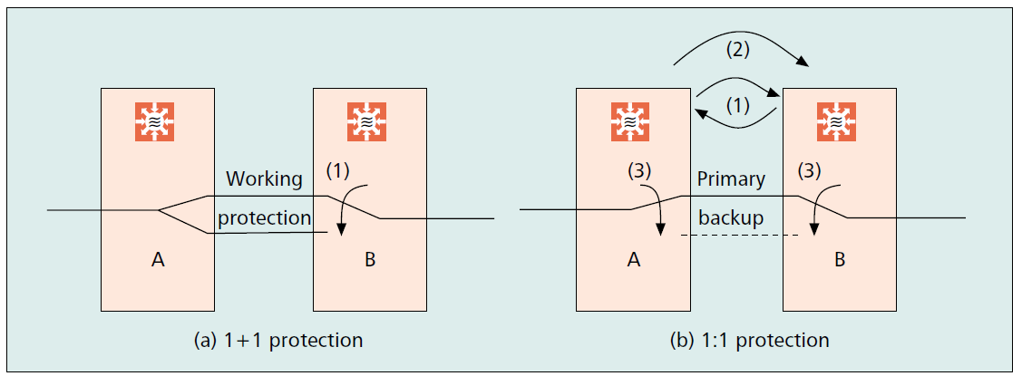
Protection & Restoration
Compared to protection techniques, restoration is more flexible and generally makes a much more efficient use of the network capacity.
Restoration takes a longer time to restore the traffic affected by the failure, due to the need to find a new route in the network.
In general:
automatic protection can be applied to network architectures as point to point, rings and meshed networks
restoration is usually applied to meshed networks with cross-connect equipment.

Slide 55
Restoration Process
The main steps of the restoration process can be summarised as follow:
Detection of the failure
the failure is detected by the Network Elements and the defect is notified to the Restoration Control Unit (a Network Manager OS, for instance)
Propagation of control messages
the control information is propagated between Network Elements and/or Control Units (if required)
Selection of the new route
based on the spare resource available in the network, an alternative route for each affected demand is selected.
Re-routing
the demands are re-routed by a re-configuration of cross-connects.
Return to normal
generally, after fault recovery, the network returns to the initial state, either automatically or manually.

Slide 56
Restoration Techniques Control Architecture
Centralised control architecture
The restoration process is operated from a Central Control Unit (CCU) that gets all the information concerning the status of the network, via control communication links and databases
The databases can be either centralised or distributed
The CCU may be integrated to the OS, combining capacity planning with restoration
No communication is required between cross-connects, allowing a great compatibility in terms of equipment
Distributed control architecture
The restoration process is operated by a number of Control Units located in each Network Element (NE). Each NE then reacts according to a set of rules to a local alarm or a message from an adjacent NE
The information about the status of the network is distributed between a large number of databases located in the NEs together with CUs
Each NE maintains in its database only local network information (connections to neighbouring nodes and paths, for instance)
The NE does not have a global network view and the restoration process requires the exchange of many control messages between NEs, according to a simple set of rules

Slide 57
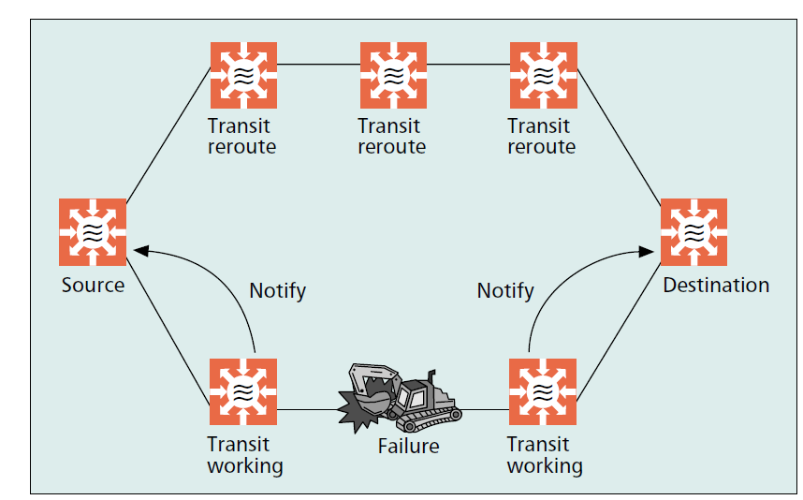
Restoration Techniques Control Architecture
Differences between centralised and distributed restoration:
Distributed control offers restoration times around 2 seconds. For centralised control architecture restoration times are within 20-40 seconds
With a centralised controllers it is easier to monitor the network configuration than with distributed controllers. This makes it also easier the return to normal
A scheme with centralised control does not require communication between cross-connects and therefore concerns about vendor dependence are minimised

Slide 58
End of session 9

